Slide 1

Housing Price Predictions
Using Machine Learning Model

Slide 2
Purpose
Predict the prices of housing market in upcoming years.
Advice families to plan and budget accordingly .
To identify market trends and patterns.

Slide 3
Which Dataset are we using ?
We are using “Ames Housing Dataset” from Kaggle. The dataset includes almost all the required information about a house which includes: property area, features, year built and sale prices etc.

Slide 4
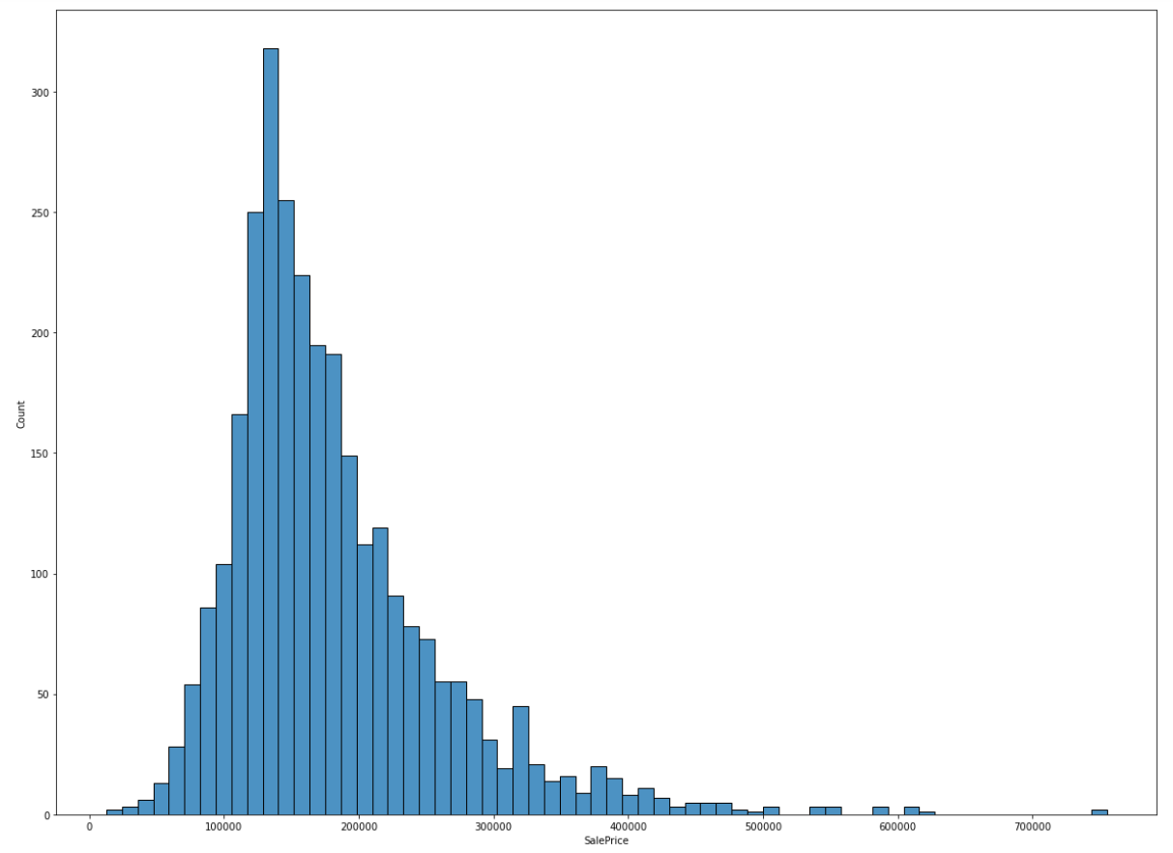
Exploring our Dataset:
Importance:
It is always best practice to first understand the type of dataset you are working with
This will provide you with initial insights that you may not be able to comprehend directly through a dataset
We can get a better understanding of the distribution of our target variable (sale price)
Understanding:
This graph is comparing the number of homes sold at the specific sale price listed below in the Ames housing district.
We can see that through our boxplot that a majority of the homes in the area are sold somewhere between the range of $140 000 & $160 000

Slide 5
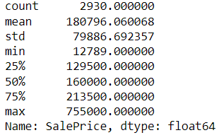
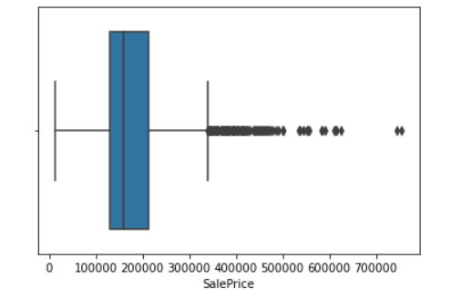
Exploring our Data Analysis:
Interquartile Range:
These numbers provide us with an Interquartile Range (IQR) of our target variable Sale Price
This enhances our understanding of our boxplot visual provided in the previous slide
We can understand our outliers better and see how far some of these data points may lie outside of our IQR
Box - Whisker Plot:
The box and whisker plot shown below gives us a clearer visual understanding of our IQR
We can see that there are more variables skewing the prices to the higher end the of Sale Price
We can use this information to further investigate why this may occur and features that may be causing these skewed results

Slide 6
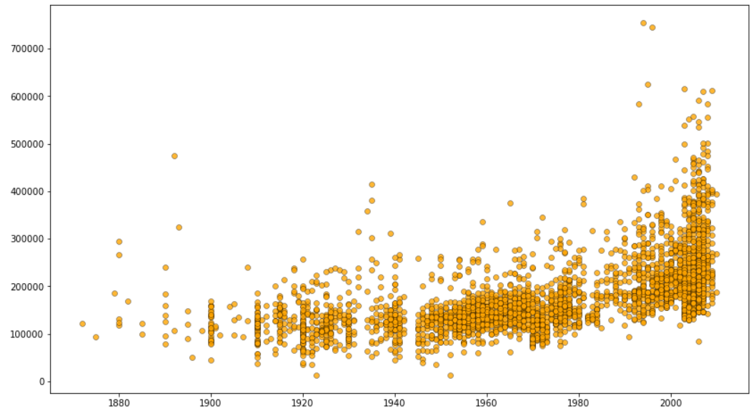
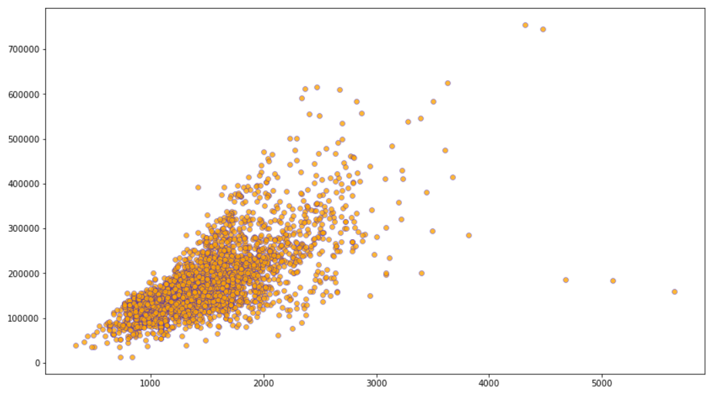
Analyzing Co-Relation with Certain Feature Variables:
Year Home was Built vs. Sale Price | Greater Living Area vs. Sale Price
This graph provides valuable insight, informing us that more of the expensive houses were recently built We can also investigate why a home built prior to 1900, is valued at $500 000. This could potentially be due to additions/renovations made to the property after acquiring it Potential Insight/Questions: Are we not considering renovations and upgrades made to the home correctly in our dataset? | We can see that for more of the homes they linearly increase in price when the size of the home increases A few variables that can be categorized as outliers based off this visual could be homes with 5000 sq ft. is costing less than $200 000. Potential Insight/Questions: Was this home sold as a rush sale? Are there other factors causing this data point? Should we include it in our dataset?

Slide 7
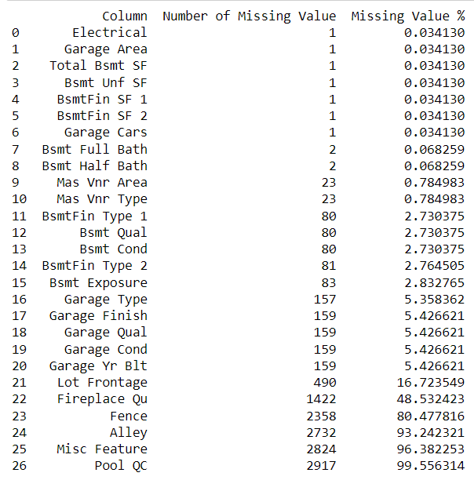
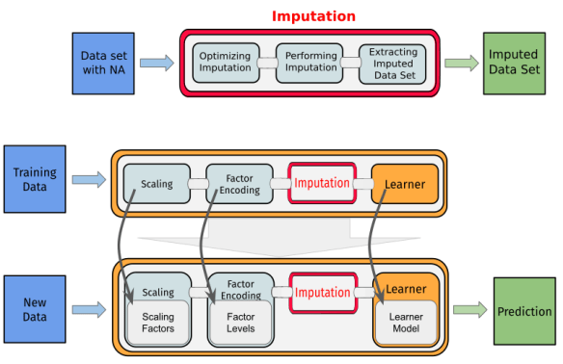
Refining Data: How to Handle Missing Values?
When viewing this info, we must question what our cutoff point is for removing columns altogether and when should we just remove specific rows so that we don't alter the outcome of our dataset.
In our testing phase, I believe that we can outright remove columns that have more than 60% of data missing
I also feel that we should double-check how significantly correlated are these values with our target variable Sales Price
There are two columns that are above 10% and less than 60% missing data, we can further investigate whether we should replace these values with their mean result or outright remove the rows that don't have any data value inputted
If we do plan on inputting data for the missing rows, we must determine what type of variables are produced for these columns (i.e. numerical or categorical)

Slide 8
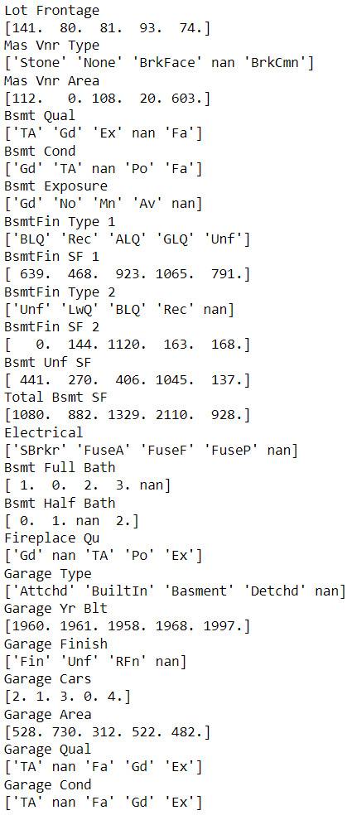
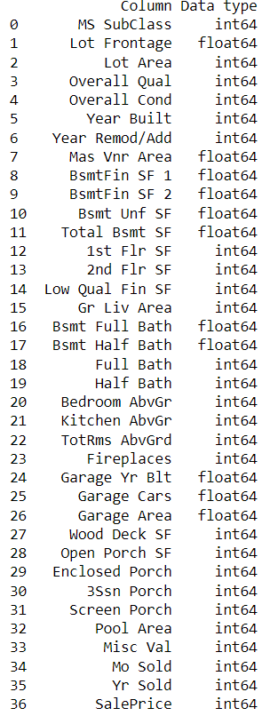
Refining Data: What type of variable is the missing data?
For the image on the left, we can determine what type of data we currently have, we should always double-check to confirm that Pandas is also recognizing the data correctly.
We would run the specified code and compare our results with both images (left & right) to determine that this is being captured correctly
The reason for the above step is that when we use Pandas it will attempt to automatically recognize what type of data we are using, and it might not always be 100% accurate
If we do not check for this, it can produce incorrect results and cause our Machine Learning model to not perform as accurately as we would want it to

Slide 9
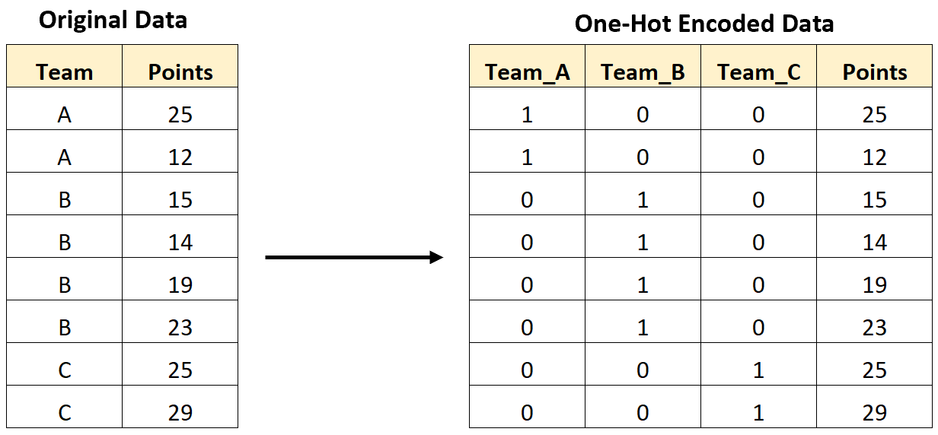
One-Hot Encoding our Categorical Variables:
Importance:
It makes our training data be more productive and expressive, it can also be modified when required
This allows for Bernoulli Distribution as you only have 1 of 2 options it either falls under one category (yes) or the other category (no)

Slide 10
Team Members
Jagbir Singh
Nishan Manoharan
Sukhbir Singh
Chenglu Yang

Slide 11
Resources
Link to Dataset: https://www.kaggle.com/datasets/prevek18/ames-housing-dataset

